Slide 1
Project Title: Dropout Risk Detection
Student Name:
Angel Xavier-01
Taanshu Babariya-03
Mariam Badure-04
Jaden Borges-08
Batch: A1
Course: ML Mini Project
Guide Name: Dr. Joanne Gomes
Institute Name: St. Francis Institute of Technology

Slide 2
Problem Statement (Revised)
Many students drop out due to low performance and lack of engagement.
Institutes need a reliable way to identify at-risk students early.
Existing systems lack real-time prediction and behavioral analysis.
This study focuses on using student data + machine learning to classify students as At-Risk/Not At-Risk.
Goal: build an accurate prediction model to support early intervention

Slide 3
Dataset Details
Dataset Source
Name: Predict Students' Dropout and Academic Success
Source: Kaggle / UCI Machine Learning Repository
Number of Samples
Rows (instances): 4,424 students
Features: 36 input features + 1 target column
Feature Description
The dataset includes student demographic, academic, financial, family, and economic details.
Demographic: gender, age, nationality
Academic: course, previous grades, semester performance
Financial: fees status, scholarship, debtor
Family: parents’ education & occupation
Economic: unemployment, inflation, GDP

Slide 4
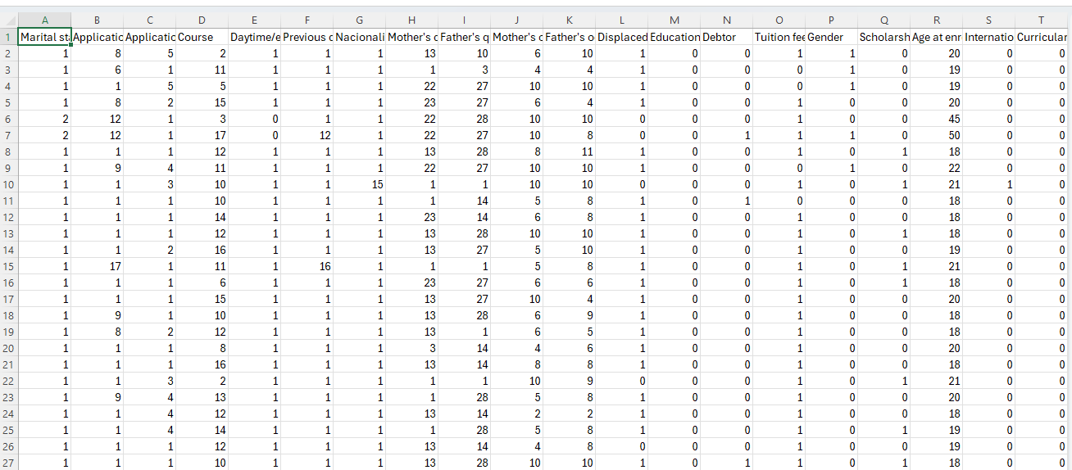
Sample Data Snapshot

Slide 5
Data Understanding
Types of Data
Numerical: grades, age, GDP, inflation, unemployment
Categorical: gender, course, marital status, scholarship
Dataset includes continuous, integer, and categorical values.
Missing Values
No missing values in the final dataset
Missing and anomalous records were already handled during preprocessing by the dataset creators.
Data Distribution Insights
Class imbalance present
More Graduate samples than Dropout
Semester grades and approved credits strongly influence the target
Academic features are the most predictive factors

Slide 6
Preprocessing Plan
Handling Missing Values
No missing values
Dataset is already cleaned and ready to use
Encoding Categorical Variables
No additional encoding required
All categorical fields are already label encoded as numeric values
Features can be directly used for ML models
Normalization / Scaling
Use StandardScaler
Important for Logistic Regression, SVM, DNN
Less important for tree-based models

Slide 7
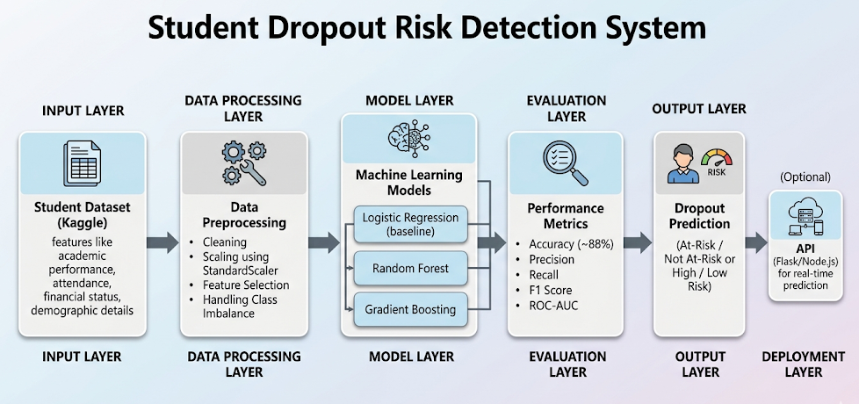
System Block Diagram
Input → Processing → Model → Output

Slide 8
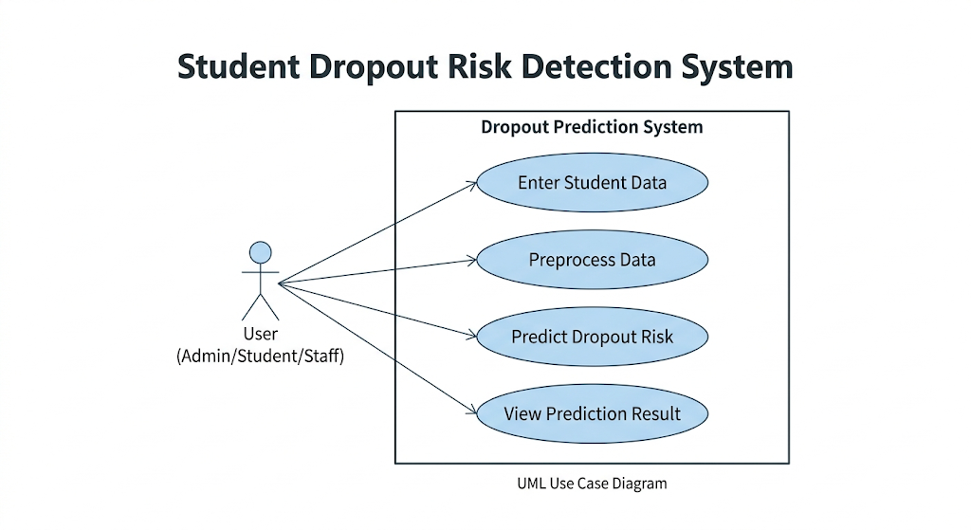
UML Diagrams
Use Case Diagram

Slide 9
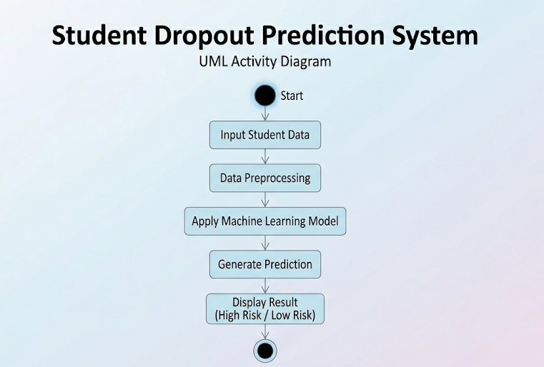
Activity Diagram

Slide 10
Algorithm Selection
Algorithms Shortlisted
Logistic Regression
Random Forest
Gradient Boosting
Reason for Choosing Each
Logistic Regression: simple, fast, and strong baseline classifier
Random Forest: handles non-linearity, reduces overfitting, gives feature importance
Gradient Boosting: high accuracy by learning from previous model errors
Baseline Model
Baseline: Logistic Regression
Chosen because it is easy to train, interpretable, and widely used for classification

Slide 11
Feature Selection
Selected Features
Personal: age, gender, marital status, nationality, international
Academic background: previous qualification, application mode/order
Semester performance: enrolled, approved units, grades, evaluations
Financial/social: fees status, debtor, scholarship, course
Economic/family: unemployment, inflation, GDP, parents’ education
Justification
Semester approved units + grades → strongest academic predictors
Tuition fees, debtor, scholarship → financial stress indicators
Age and family background → personal support & responsibility factors
Economic indicators → external stress on continuation
Domain Knowledge Used
Low grades → poor academic progress
Fee delays → financial hardship
Scholarship → higher motivation
Older/married students → more outside responsibilities

Slide 12
Evaluation Metrics for Project
Performance Metrics
Accuracy: overall correct predictions (~88%)
Precision: how many predicted dropouts were truly dropout
Recall: how many real dropouts were correctly identified
F1 Score: balance between precision and recall
ROC-AUC: model’s ability to separate dropout vs non-dropout
Why These Metrics?
Accuracy: quick overall performance check
Precision: reduces false alarms
Recall: most important — avoid missing real at-risk students
F1 Score: useful for imbalanced data
ROC-AUC: best for comparing multiple models

Slide 13
Tools & Technologies
Programming Language
Python
Chosen for strong ML ecosystem, easy syntax, and fast experimentation
Libraries Used
NumPy → numerical operations
Pandas → data loading & preprocessing
Scikit-learn → train-test split, models, metrics, scaling
Warnings → suppress unnecessary warnings
Platform / Tools
Google Colab
Python environment with Scikit-learn
Dataset from Kaggle

Slide 14
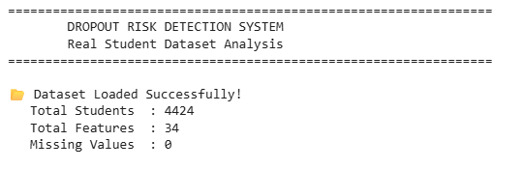
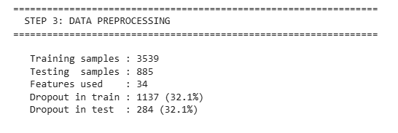
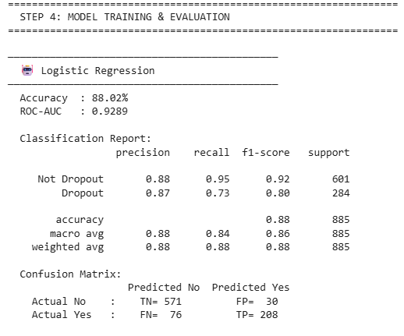
Initial Implementation
Data loaded successfully
Preprocessing completed
Logistic Regression model trained

Slide 15

Initial Results
Accuracy: 88.02%
ROC-AUC: 0.9289
Precision: 0.87
Recall: 0.73
F1-Score: 0.80
Observations
Strong overall accuracy (88%)
High performance in identifying non-dropout students
Recall of 73% means most at-risk students were detected
Some 76 dropout students were missed, so recall can still improve
Good baseline model for comparison

Slide 16
Challenges Faced
• Understanding dataset features and their meaning
• Handling class imbalance in dropout data
• Selecting the most relevant features
• Choosing appropriate ML models
• Improving recall for dropout prediction

Slide 17
Plan for Next Phase
Model Improvement
Tune hyperparameters for better recall
Try XGBoost / LightGBM / Deep Learning
Use SMOTE for better class balance
Perform advanced feature selection
UI / Deployment Plan
Build a web dashboard using Streamlit / Flask
Input student details manually or via CSV
Show dropout risk score + intervention suggestions
Deploy on Render / Hugging Face / Streamlit Cloud
Paper Writing Start
Document problem statement, dataset, methodology, results
Compare shortlisted models
Include graphs, confusion matrix, ROC curves
Write future scope and real-world education impact

Slide 18
Deliverables
Deliverable 1: Dataset file (.csv)
• Student dataset from Kaggle
Deliverable 2: Jupyter Notebook
• Data loading
• Data preprocessing
• At least one ML model
• Model evaluation
Deliverable 3: GitHub Repository
• Complete project uploaded on GitHub
• Link:
https://github.com/taanshubabariya-cyber/AIML-ML-LAB-03/tree/main/Mini_Project
Deliverable 4: Block Diagram Image
• System architecture diagram

Slide 19
References
• Kaggle Dataset: Predict Students’ Dropout and Academic Success
• Villar & Andrade (2024) – Discover AI
• Marcolino et al. (2025) – Scientific Reports
• Cho et al. (2023) – Applied Sciences
• Kim et al. (2023) – Applied Sciences

